Slide 1



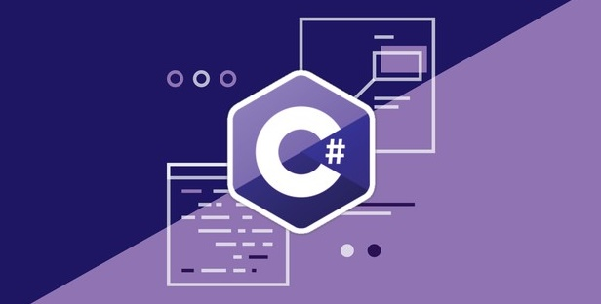
Programming Fundamentals
Course Introduction
Programming Fundamentals
SoftUni Team
Technical Trainers
Software University
http://softuni.bg

Slide 2









SoftUni Diamond Partners

Slide 3



Table of Contents
Course Objectives
Course Program
Trainers Team
Examination
Learning Resources

Slide 4
Questions
sli.do #tech-softuni

Slide 5

Tech Module @ SoftUni
4 Months Technology Fundamentals Training

Slide 6
Tech Module Goals
4 months intensive technology fundamentals training
4 times weekly, lots of live coding and exercises
Part I – Programming Fundamentals
Source control systems, arrays, lists, dictionaries, LINQ, objects, files, strings, regular expressions, …
Part II – Software Technologies
Get acquainted with the most popular technologies out today
PHP Web, JavaScript Web, Java Web, C# Web

Slide 7
Tech Module at SoftUni – Timeline
16-Jan-2017
27-Feb-2017
May-2017
Programming Fundamentals
Lessons + exercises + exam
6 weeks * 4 times / week
6 credits
Start: 16-Jan-2017
Final exam: 26-Feb-2017
Software Technologies
Lessons + exercises + team work project
8 weeks * 4 times / week
12 credits
Start: 27-Feb-2017
Teamwork Defense: 28-Apr-2017, 29-Apr-2017
Programming Fundamentals Re-Take Exams
First week of May 2017

Slide 8
Professions @ SoftUni
Programming Basics
Java
Fund.
Java
DB
Java
Web
JS Core
Tech Module
C#
Fund.
C#
DB
C#
Web
JS Core
Programming Fundamentals
JS Core
MEAN
Stack
Web
Basics
Software Technologies
PHP
Web
Web
Basics
JS Core
https://softuni.bg/curriculum
https://softuni.bg/trainings/courses

Slide 9

Programming Fundamentals
Course Objectives & Program

Slide 10

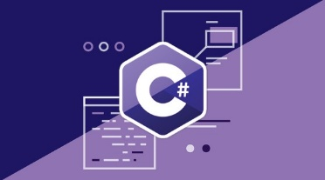
Programming Fundamentals – Course Program
Course Introduction Version Control Systems – Git and GitHub
Data Types and Variables
Methods – Defining and Invoking Debugging and Troubleshooting Code
Arrays – Simple Array Processing
Lists – Variable Length Sequences
Dictionaries, Lambda and LINQ

Slide 11
Programming Fundamentals – Course Program (2)
Objects and Classes – Using Objects and Classes
Files and Exceptions – Read / Write Text Files
Strings – Text Processing
Regular Expressions – The Art of Modern Text Processing
Exam Preparations (4 times)
Practical Exam

Slide 12
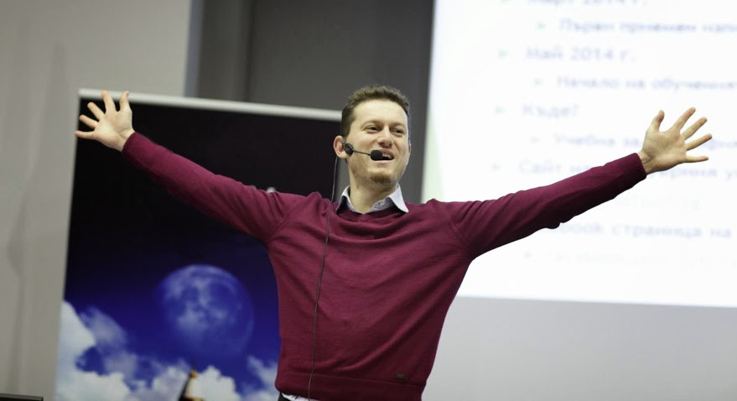
The Trainers Team

Slide 13
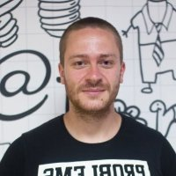

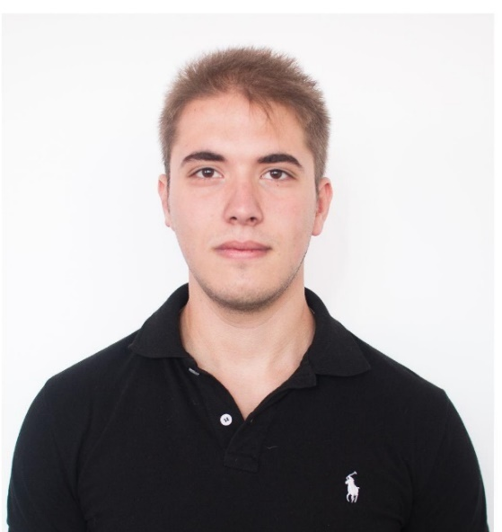
Trainers Team
Ivaylo Kenov
Senior Software Engineer & Trainer
https://github.com/ivaylokenov
Vladimir Damyanovski
Junior Trainer
Ivo Zhelev
Junior Trainer

Slide 14
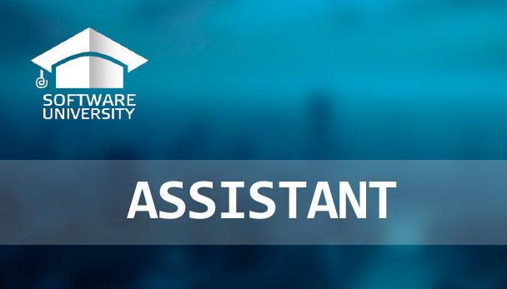
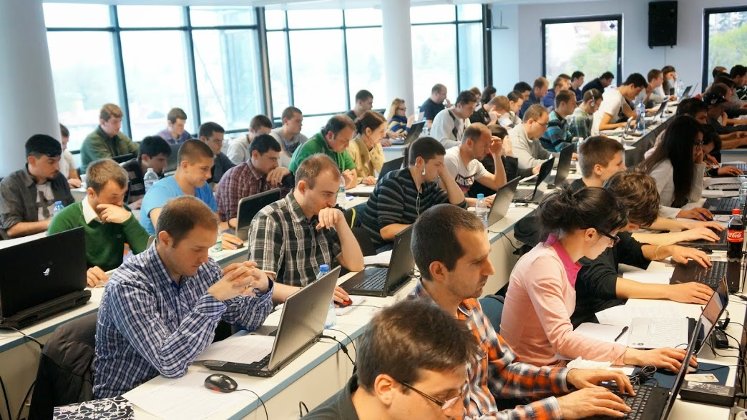
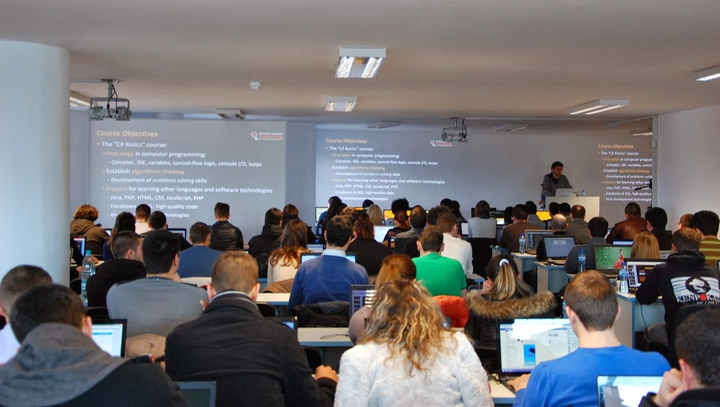
Volunteer Teaching Assistants
Volunteer teaching assistants
Developers from the software industry
Scholarship students from SoftUni

Slide 15
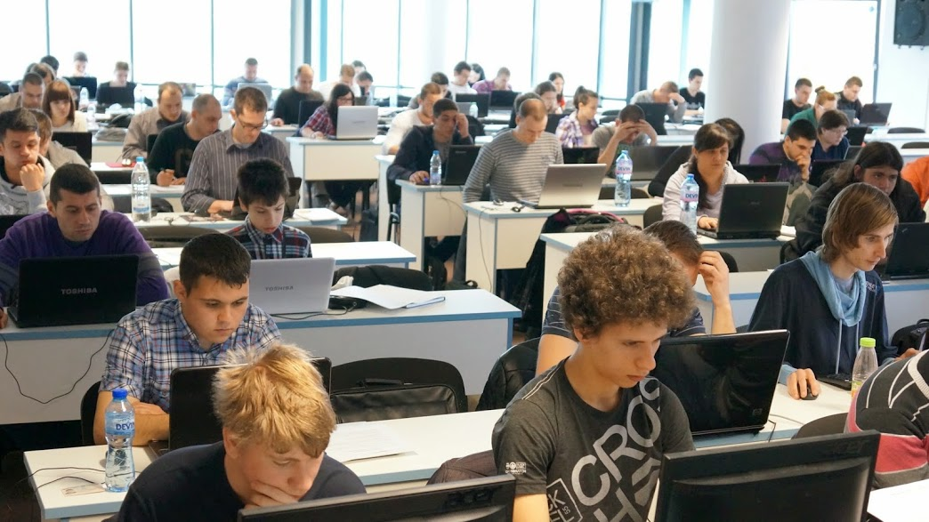
Programming Fundamentals: More Details
Duration, Languages, Technologies

Slide 16

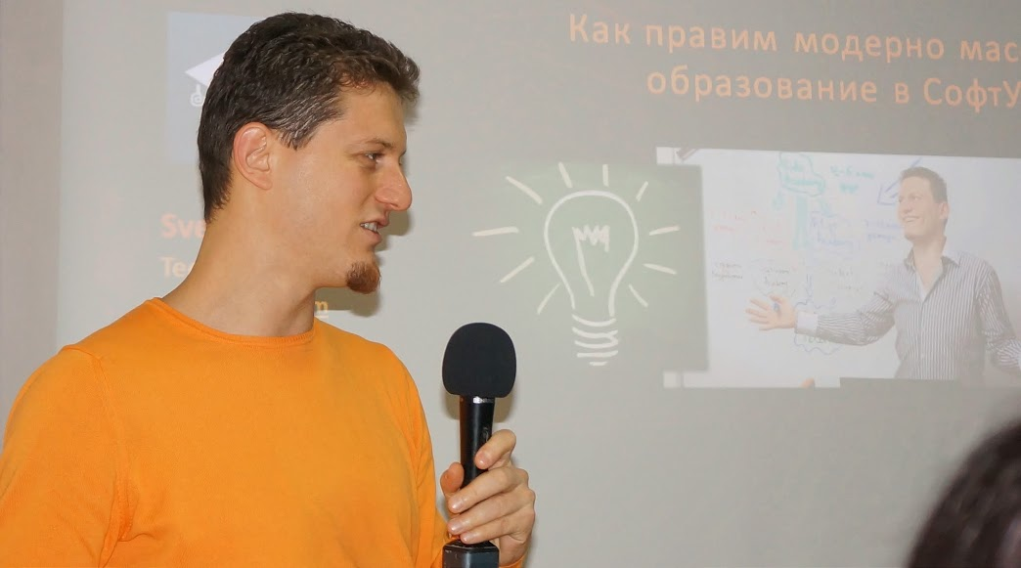
Training Duration – Programming Fundamentals
Lectures: ~30 hours (onsite + videos)
Practical exercises (in class): ~70 hours
Exam preparation: 4*6 hours
Exam: 6 hours
Schedule: January 2017
Exam date: 26 February 2017

Slide 17



Why English?
Why the slides are in English?
English is the native language of the software engineers
Specific terminology should be in English
Translations are inaccurate and funny
Just learn English!
No excuses

Slide 18
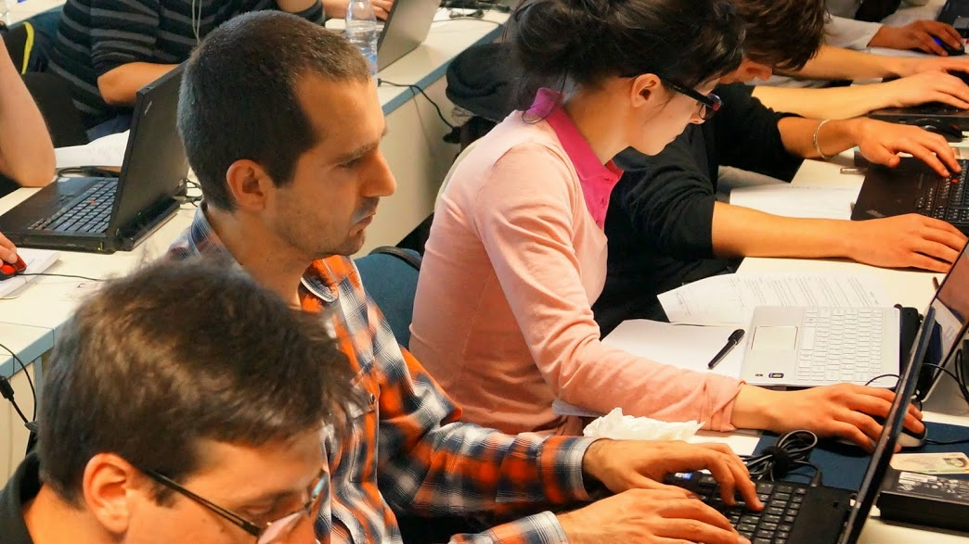
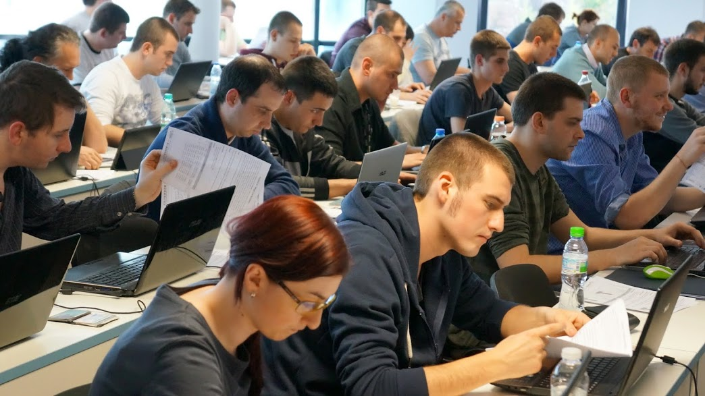

Programming Fundamentals
Evaluation Criteria

Slide 19


Scoring System for “Programming Fundamentals”
Exam – 90%
Homework (exercises) – 10%
Bonuses: up to 10%
Presence in class: 5% (onsite students only)
Forum activities
Others

Slide 20
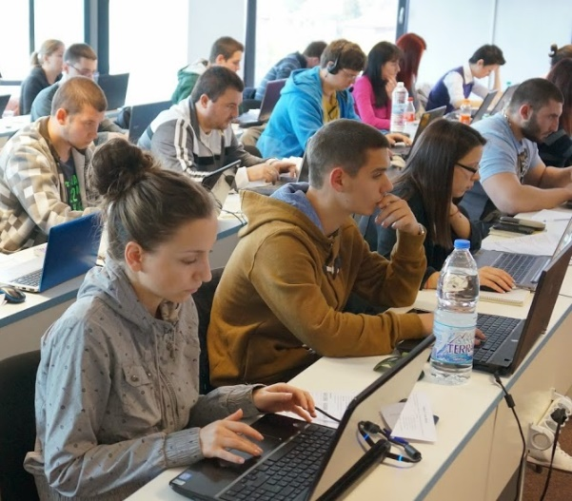

Programming Fundamentals Exam
Practical programming exam
4 practical problems for 6 hours
Simple arrays, lists, dictionaries, strings
Code in C# (Java, PHP, JS are also welcome)
Automated judge system
http://judge.softuni.bg
Solutions are evaluated for correctness only
Code quality is still not measured

Slide 21

Homework Assignments
Doing your homework is very important!
Programming can only be learned through a lot of practice!
You should write code every day!
Each lecture is followed by many exercises
Try to solve them in class
The rest are your homework
Homework assignments are due in 6 days after each lecture
Submission through our online judge system: judge.softuni.bg

Slide 22










Resources
What We Need Additionally?

Slide 23
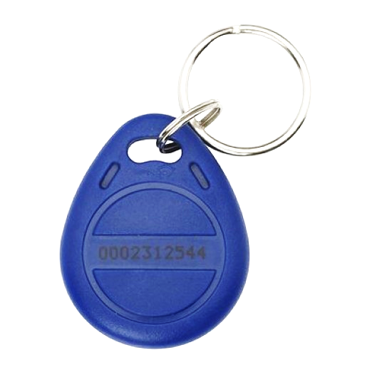
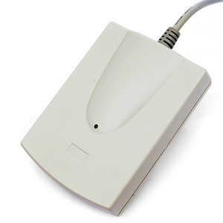
Your RFID Chip
Students can either
Take RFID chip from SoftUni
Or use their own chip / card
Register your chip number in your SoftUni profile: https://softuni.bg/users/profile/show
Check-in at the reception every time when you come
See your last visits in your profile: https://softuni.bg/users/profile/show

Slide 24

Course Web Site & Forums
The Programming Fundamentals official web site:
Register for the "Software University Forum":
Discuss the course exercises with your colleagues
Find solutions for all course exercises
Share source code / discuss ideas / help each other
https://softuni.bg/courses/programming-fundamentals/
https://softuni.bg/forum/categories/44/

Slide 25
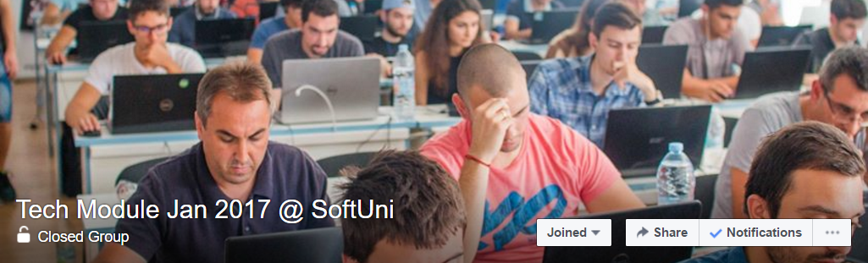

Facebook Group
Tech Module January 2017 Facebook Group:
https://www.facebook.com/groups/softuni.tech.module.jan.2017/
Post questions, problem solutions, tips and tricks, etc…
Discussion is very encouraged!

Slide 26



Programming Fundamentals Slides and Videos
All lecture slides, videos, homework assignments, projects and other resources are open content, available for free
Visit the course web site to access the course resources

Slide 27
The Free C# Fundamentals Textbook
The official textbook for the course
"Fundamentals of Computer Programming with C#", by Svetlin Nakov & Co., 2013, ISBN 9789544007737
English and Bulgarian versions (as PDF, ePub, …)
Freely downloadable from: www.introprogramming.info
The C# Programming courses @ SoftUni.bg partially follows the book
Programming Fundamentals → chapters 2, 3, 7, 9, 11, 13, 14, 16, 18, 22

Slide 28

Software University Learning System (SULS)
Software University Learning System (SULS)
www.softuni.bg
Important resource for students
Homework submissions
Homework check-up
Exams and results
Reports about your progress

Slide 29


Required Software
Software needed for this course:
Microsoft Windows (Win 10 / 8.1 / Win8 / Win7) or Mac or Linux
Visual Studio Community 2015 (a free version of VS 2015)
Visual Studio 2013, 2012, 2010 acceptable, but not recommended
Alternative: MonoDevelop

Slide 30


Summary
Training program
Data types, methods, debugging, arrays and lists, dictionaries, objects, strings and much more
Practical exam
4 problems for 6 hours
Learning resources
Slides, videos, software, books, forum

Slide 31
Programming Fundamentals – Course Introduction
https://softuni.bg/courses/programming-fundamentals

Slide 32
License
This course (slides, examples, demos, videos, homework, etc.) is licensed under the "Creative Commons Attribution-NonCommercial-ShareAlike 4.0 International" license

Slide 33



Trainings @ Software University (SoftUni)
Software University – High-Quality Education, Profession and Job for Software Developers
softuni.bg
Software University Foundation
softuni.org
Software University @ Facebook
facebook.com/SoftwareUniversity
Software University Forums
forum.softuni.bg

